Slide 1


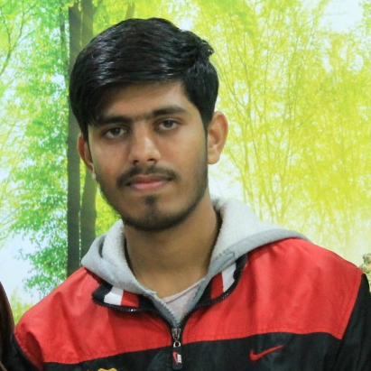
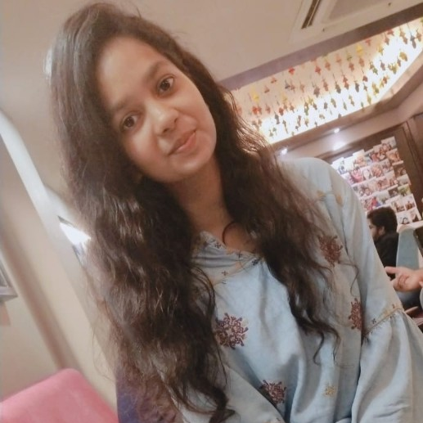
Aaveg Gupta
Krishna Gopal Patidar
Anushka Dwivedi
HACKSPRINT

Slide 2


Problem Statement : Stock Market Price Prediction for the next 10 days using machine learning
Problem Statement Number : PS05
Team Name : Neoteric
Team Leader Name : Krishna Gopal Patidar
College Name : Indore Institute of Science and Technology

Slide 3







TECH-STACK AND DESCRIPTION
REACT
React is used to make the financial News Webpage and all the necessary web-design.
STREAMLIT
Streamlit will be used as a Django
or Flask framework to make our web-page much more appealing.
DEEP LEARNING
In Deep Learning, we are using RNN Model for stock market prediction and more specifically LSTM.
QUANDL
All the Stock Market data of Nifty-50 will be fetched from Quandl.
HEROKU
Both the website and the Deep
Learning models will be deployed on Heroku Servers.
NODE.JS
Node.js used as JavaScript runtime environment that executes JavaScript code outside a web browser.
NEWS API
Newsapi.org will be used to fetch out
All the finance and business related news.

Slide 4
DAY-1 PROGRESS
Home Page of our Predictor
Chatbot implementation on Dialogflow
News Page Integration
Linear Regression on Data
Moving Average
Deep Learning LSTM implementation
Streamlit Implementation

Slide 5
DAY-2 PROGRESS
Completed the Streamlit Integration with DL
Deployed the prediction model on Heroku
Finely curated the Deep Learning Documentation
Deployed the whole web page on Heroku Servers
Minor bug fixes in Finance Chatbot

Slide 6
DAY-3 PROGRESS
Integrated every component in a web page
Enhanced the deep Learning’s LSTM Documentation
Minor bug fixes in Streamlit Web Application

Slide 7
APPLICATION
It can be used by stock traders to know the trend of market.
To predict the stock prices for the next 10 days.
Can be used to know FAQ related to finance by Realtime chatbot
To know about the Finance News on the GO.

Slide 8

EXPERIENCE
It was really a good experience to participate in this event this event provide a really good technical exposure. Everything was really good managed by coordinators.
Krishna Gopal Patidar

Slide 9
EXPERIENCE
The experience of hackathon was quite amazing. Starting from the day we got our problem statement to the final round it was a quite astonishing journey with us diving into the problem statement and researching about it to start the making project. The coordinators and admins were very helpful and supporting, the mentors too have provided us very intuitive feedback and motivated us to complete the project. The best part of the hackathon taking aside the coding thing is fillers where we really enjoyed the games and songs. Overall it was great and we have learned many things.
Anushka Dwivedi

Slide 10
EXPERIENCE
HackSprint v2.0 is one the most rigorous and coolest online hackathon I have attended. Initially, when we have got problem statement we were quite confident about it but on the way of making the final product several hurdles we have faced! From morning till night we all were coding rigorously and literally learnt a hell lot of new things and technology.
Aaveg Gupta

Slide 11
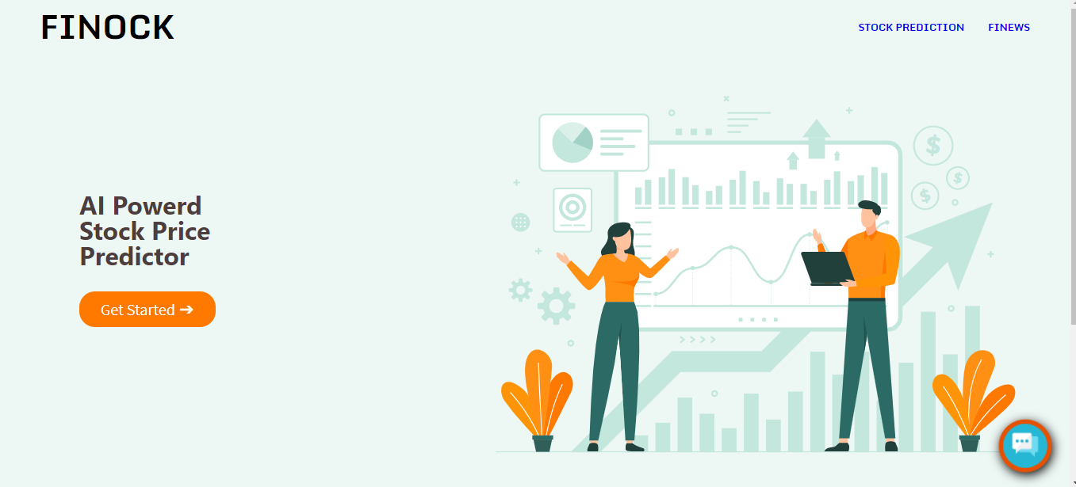
ScreenShots
HOMEPAGE

Slide 12
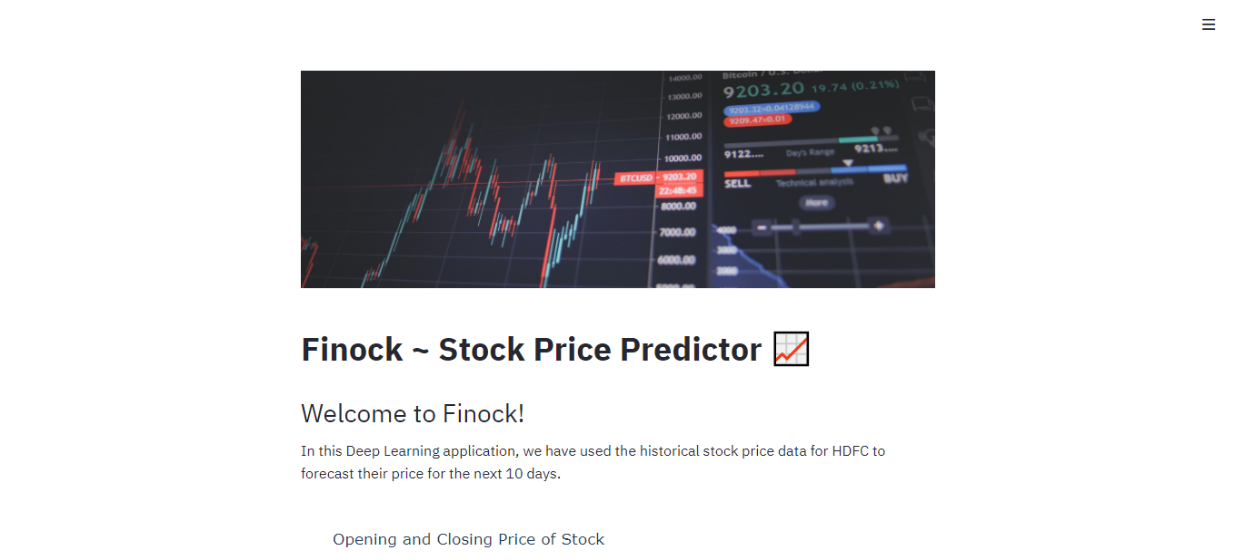
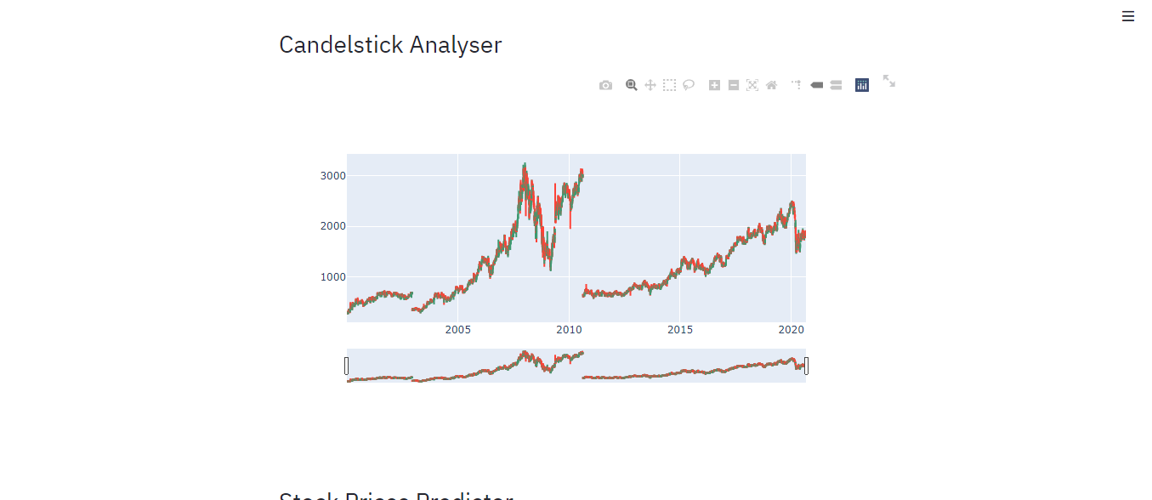
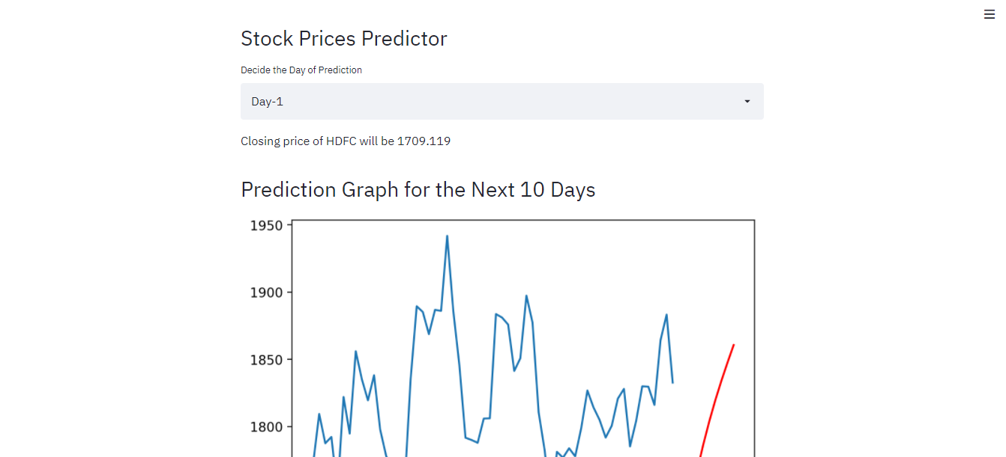
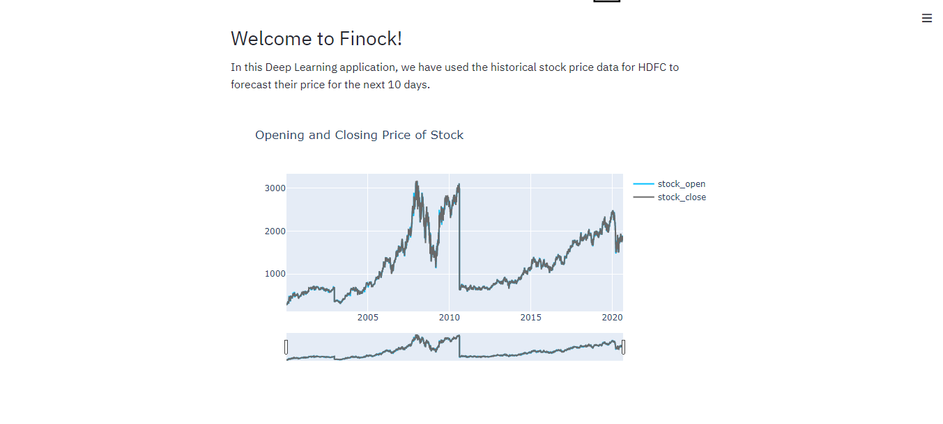
ScreenShots
PREDICTOR

Slide 13
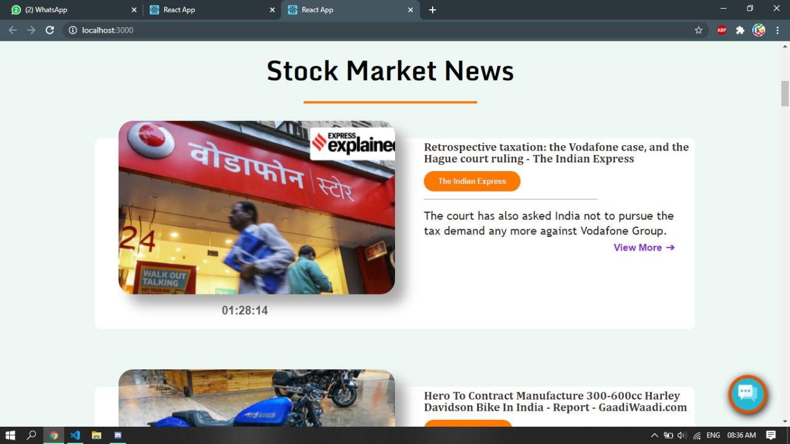
ScreenShots
NEWS-SEC

Slide 14
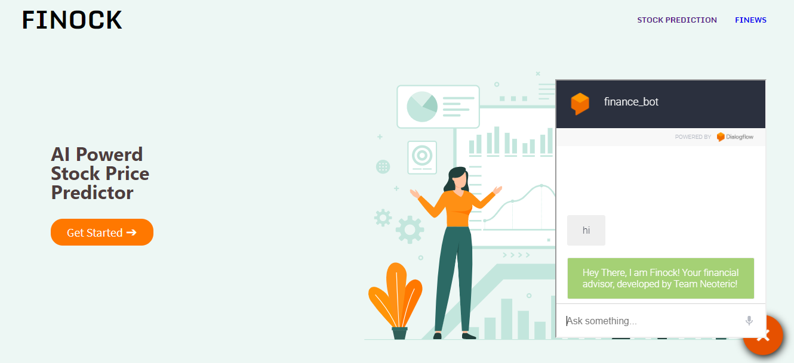
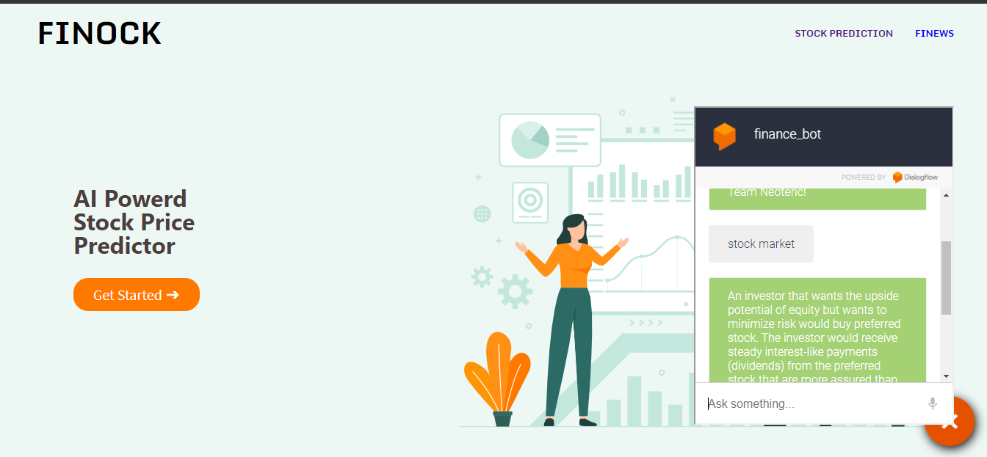
ScreenShots
CHATBOT

